Slide 1
Basic principles of deep learning
Ruichen MA
2024/8/19

Slide 2
Motivation
Foundation of Artificial Intelligence
Processing large amount of data

Slide 3
Machine Learning (ML)
Decision trees
Bayesian methods
regressions models
……
CNN
RNN
Deep Learning (DL)
……

Slide 4
Why using deep learning?
No need of feature extractor
Faster data processing speed

Slide 5
Conclusion: why is deep learning so important?
Less human work involved (building feature extractor)
Coherent with big data

Slide 6
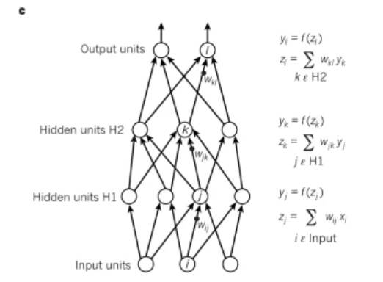
Training neural network

Slide 7

How the model’s algorism works
Use binary classification as an example:
A CV task to identify if there’s a cat in the picture
Input: A picture
Output: A prediction ($\hat{y}$) between 0 and 1

Slide 8
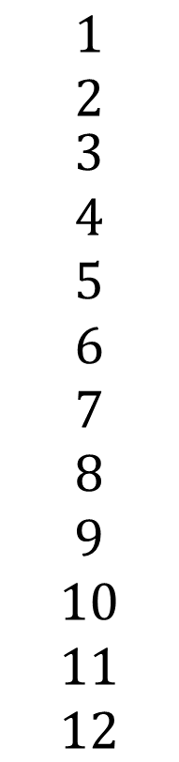
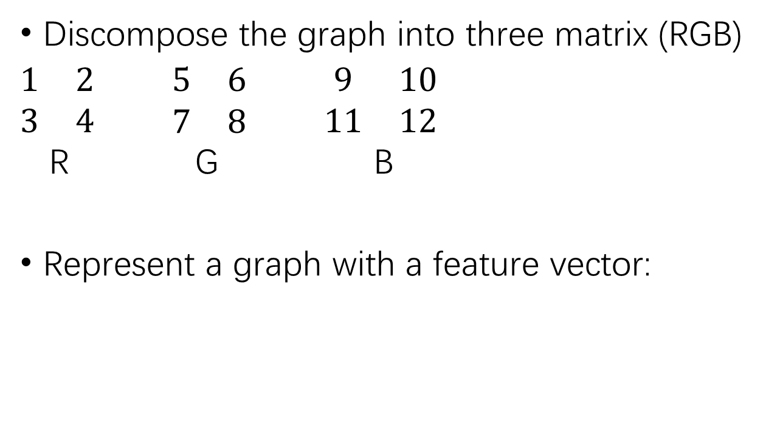
Transforming the graph
$$\begin{matrix}1 \\ 2 \\ \begin{aligned}3 \\ 4 \\ 5 \\ 6 \\ 7 \\ 8 \\ 9 \\ 10 \\ 11 \\ 12\end{aligned}\end{matrix}$$
Discompose the graph into three matrix (RGB)
$\begin{matrix}1 & 2 \\ 3 & 4\end{matrix}$ $\begin{matrix}5 & 6 \\ 7 & 8\end{matrix}$ $\begin{matrix}9 & 10 \\ 11 & 12\end{matrix}$
R G B
Represent a graph with a feature vector:
X=

Slide 9

Forming training data
Use X to represent the training dataset:
X={ ($x_{1}$,$y_{1}$), ($x_{2}$,$y_{2}$), ($x_{3}$,$y_{3}$), …… , ($x_{i}$,$y_{i}$), }
A dataset with i training samples
(y=0 or 1)

Slide 10

Using logistic regression
$\hat{y}$=P(y=1∣x)
Algorism:
$$\hat{y}=σ(ω^{T}x+b)$$
$$(ω∈R^{n_{x}}, b∈R)$$

Slide 11
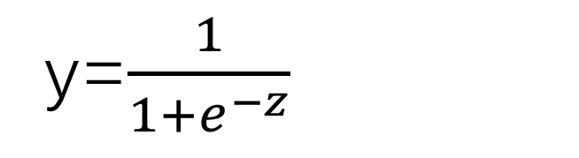
Sigmoid function
y=1
Y=0.5
y=$\frac{1}{1+e^{−z}}$

Slide 12

Calculating logistic regression loss
Loss function:
L($\hat{y},y$)=$−(ylog\hat{y}−\left(1−y\right)log⁡(1−\hat{y}))$
(not $\frac{1}{2}$($\hat{y^{2}}−y^{2}$))
Cost function:
J($ω,b$)=$\frac{1}{m}\sum_{i=1}^{m}{\text{L}\text{(}\hat{y},y\text{)}}$

Slide 13

Gradient Descent
$ω≔ω−α\frac{∂J(ω,b)}{∂ω}$

Slide 14
Reference
LeCun, Y., Bengio, Y. & Hinton, G. Deep learning. Nature 521, 436–444 (2015). https://doi.org/10.1038/nature14539 Citations:82846
Janiesch, C., Zschech, P. & Heinrich, K. Machine learning and deep learning. Electron Markets 31, 685–695 (2021). https://doi.org/10.1007/s12525-021-00475-2 Citations:2014
https://www.bilibili.com/video/BV11H4y1F7uH/

